Slide 1
University of Nottingham Final Exam Scheduling
Kien Le, Dionne Phan, Jenny Nguyen

Slide 2
Table of contents
01
02
03
04
05
Background
& Introduction
Data & Structure
Model design &
Preliminary results
Sensitivity analysis
Next steps

Slide 3
1. Background and Introduction
“My exam schedule is so bad. I have to take 3 consecutive exams from morning until dinner, and then submit a final project that is due the next morning at 10 a.m.”
→ Is this “bad” schedule simply the result of bad luck?
→ Can we design a more balanced final exam schedule that reduces stress and gives students more time to prepare?

Slide 4
1. Background and Introduction
4 central research questions:
What is the definition of a "good" exam schedule for students?
How can an exam schedule be constructed in a systematic and principled way?
What are the key bottlenecks or limiting factors that make exam scheduling difficult?
If we build a working scheduling model, how can it be applied or adapted to Denison’s exam system?

Slide 5
2. Data and Structure
Data source: Real scheduling data from Semester 1 of the 1994 - 1995 academic year at the University of Nottingham
Dataset (.txt): students, exams, enrolments, data: time, room assignment, special requirements, constraints
800 exams
7,896 students
32 time slots
16 rooms
33,997 enrolments
46 departments
4.3 exams per student
42.5 students per exam

Slide 6
2. Data and Structure
Data processing:
Convert raw datasets from .txt to .csv formats
Merge datasets and extract required variables
Manually enter department-specific constraints

Slide 7
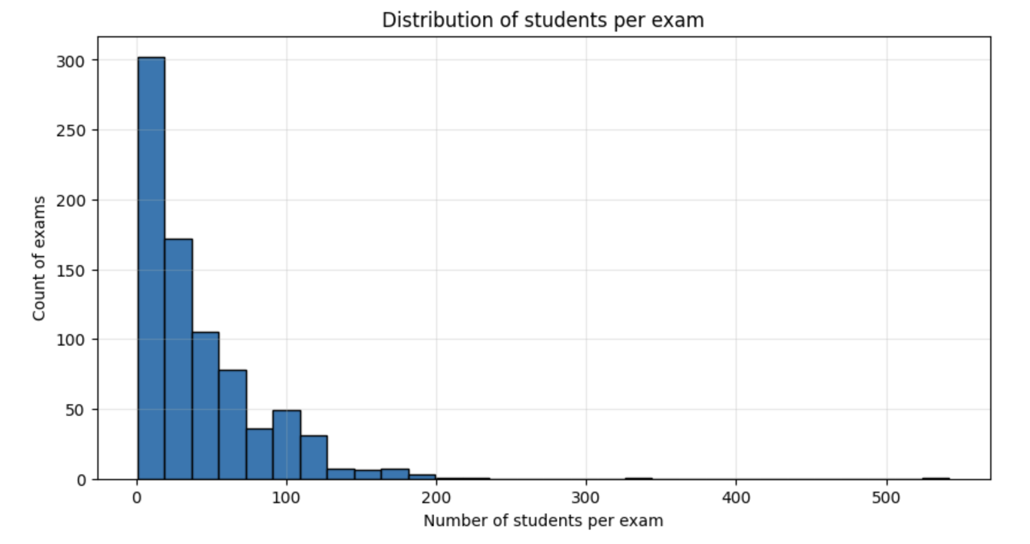
2. Data and Structure
Notes:
small student/exam -> assign fews exam into the same rooms
many exam có total students > room capacity -> divides those exam into no more than 3 rooms.

Slide 8
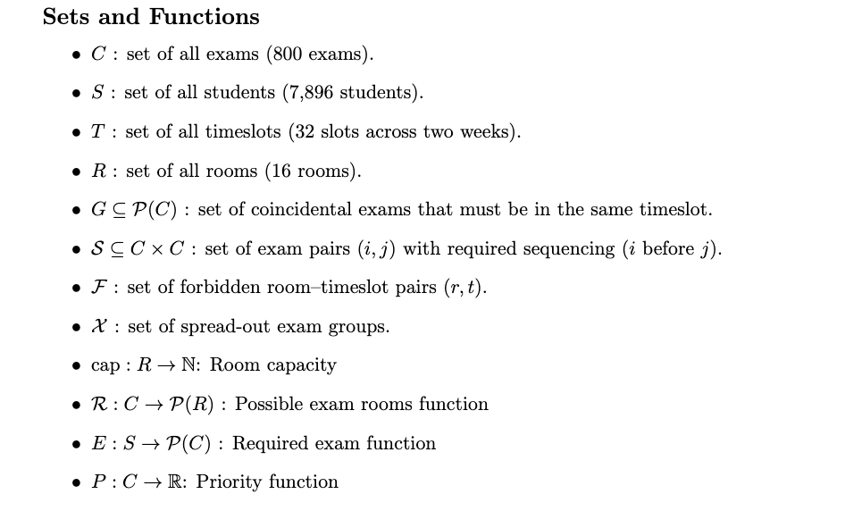
3. Model design and Preliminary results

Slide 9
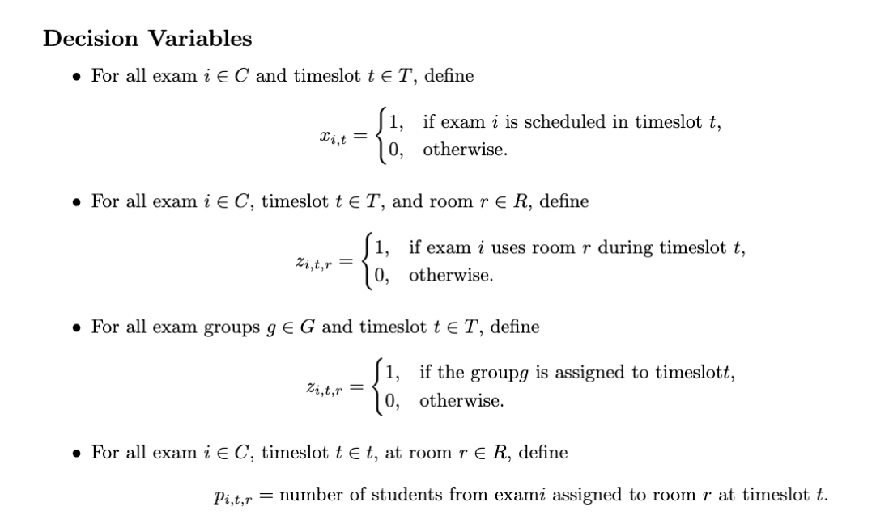
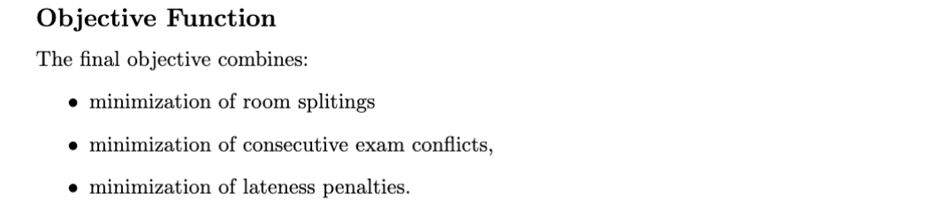
3. Model design and Preliminary results

Slide 10
3. Model design and Preliminary results
Objectives:
Construct a feasible exam timetable that satisfies all required constraints, including room capacity limits, departmental rules, and student enrollment restrictions.
Incorporate penalty terms to optimize the schedule according to additional objectives (e.g., reducing room splits, minimizing same-day exams, promoting earlier timeslots).

Slide 11
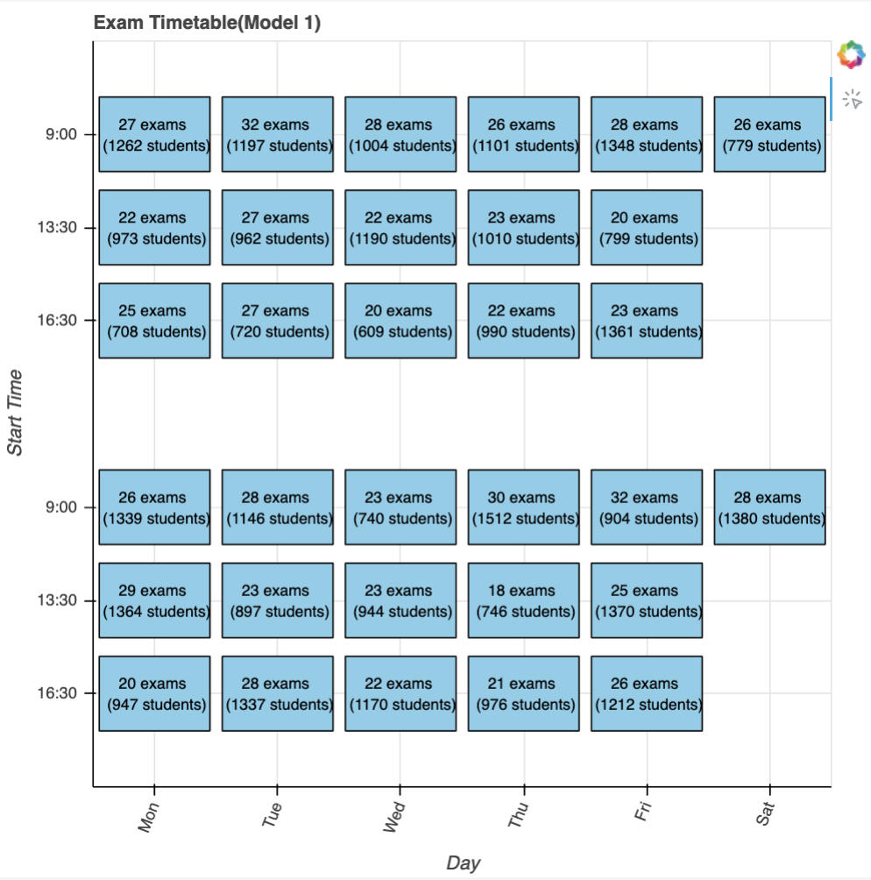
Model 1: A basic feasible exam timetabling model
Each exam must be scheduled exactly once
No student may have two exams in the same time slot
Exam duration <= time slot duration
Max capacity <= 1550

Slide 12
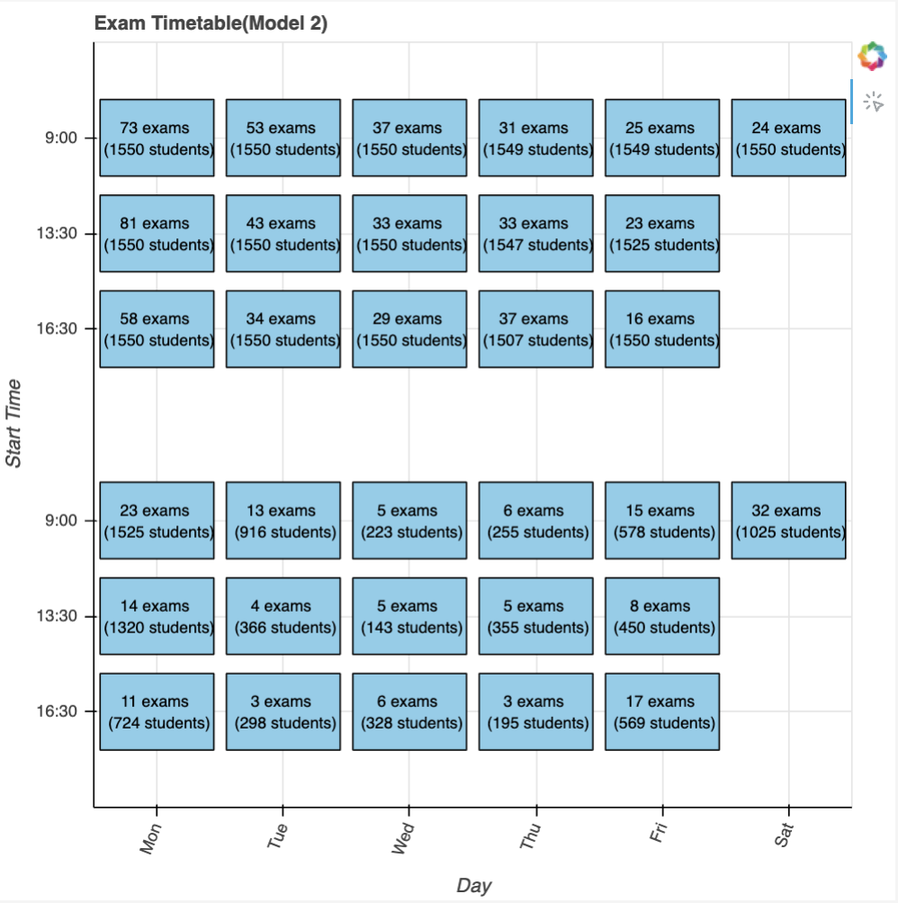
Model 2: Coincidences
All of model 1, adding:
If a group is assigned to a particular timeslot, then all exams in that group must also be assigned to that same timeslot.
Coincidences must be scheduled in the same time slot.

Slide 13
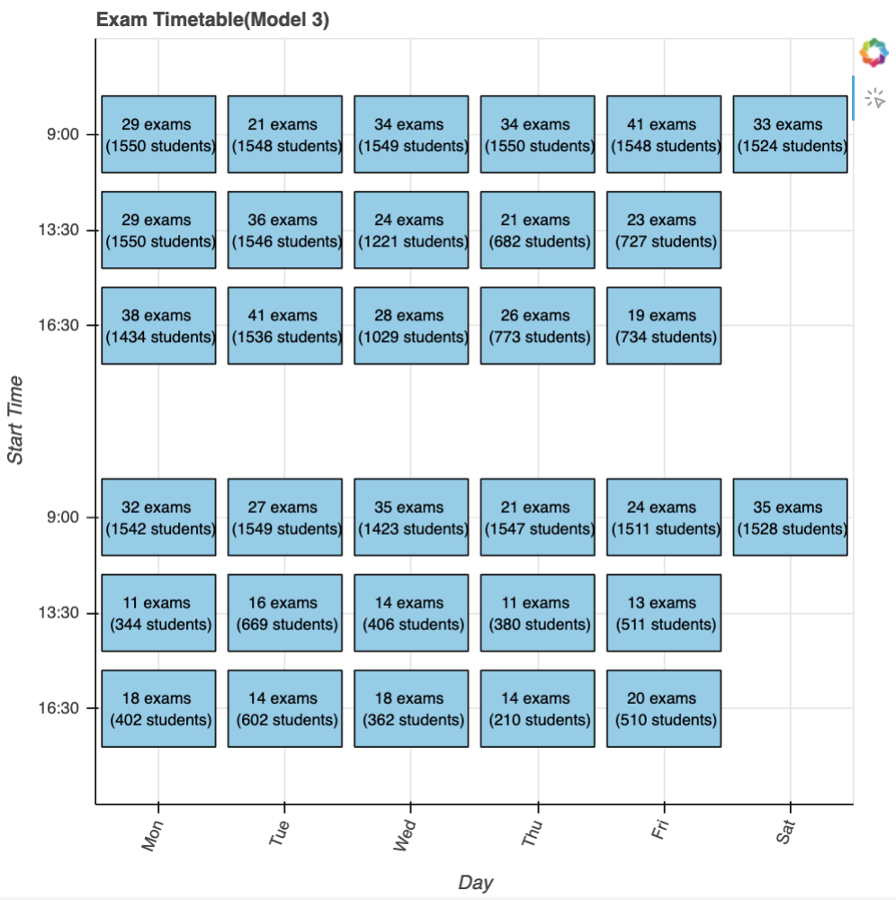
Model 3: Room assignments
All of model 2, adding:
Rooms can be used only if exam is scheduled.
Students assign to a room must be smaller than its capacity.
A room cannot hold more students than its capacity in any timeslot.
If an exam is scheduled, all of its students must be fully assigned to rooms.
Split an exam into no more than 3 room.

Slide 14
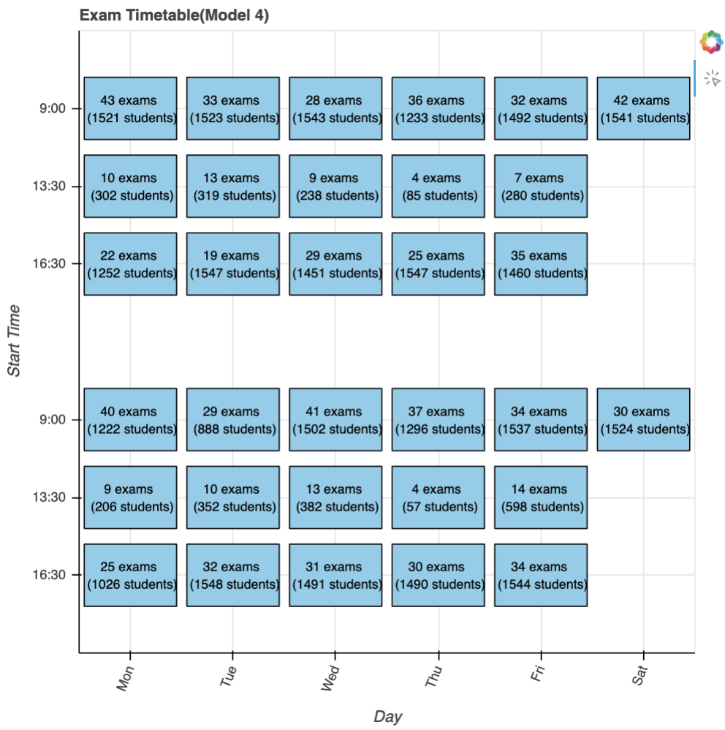
Model 4: Minimizing consecutive exam conflicts
All of model 3, adding:
Two exams must have a gap long enough

Slide 15
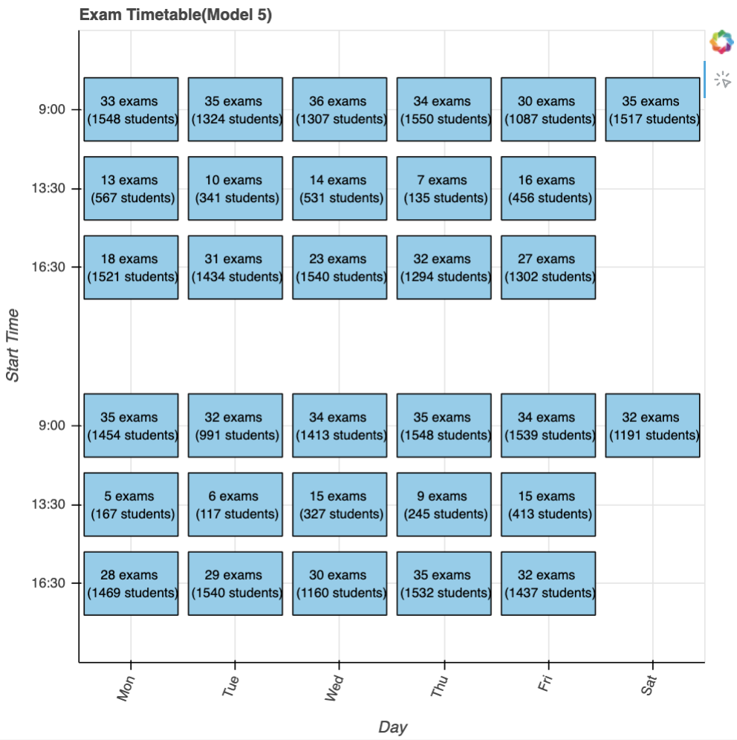
Model 5: Institutional constraints and priority scheduling
All of model 4, adding:
Institutional constraints
Priority scheduling

Slide 16
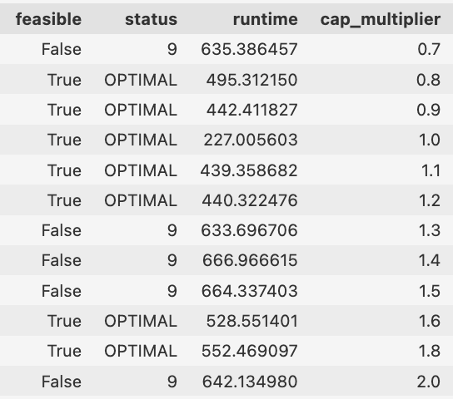
4. Sensitivity Analysis
When we vary room capacity multiplier, the model shows us a non-linear behavior.
Even very large room capacities do not guarantee feasibility, because the bottleneck is fundamentally temporal, not spatial.
Notes:
When we vary room capacity multiplier, the model shows us a non-linear behavior. The schedule is in feasible at very low capacity (0.7), becomes feasible for moderate increases (0.8–1.2), becomes infeasible again at 1.3–1.5, becomes feasible once more at 1.6–1.8, and finally becomes infeasible again at 2.0.
This pattern confirms that feasibilities do not depend only on the room capacity, but it also depend on time slots, coincidence groups or special scheduling rules, and so on. Those constraints I mentioned are all about temporal.
Even very large room capacities (e.g., multiplier = 2.0) do not guarantee feasibility, because the bottleneck is fundamentally temporal, not spatial.

Slide 17
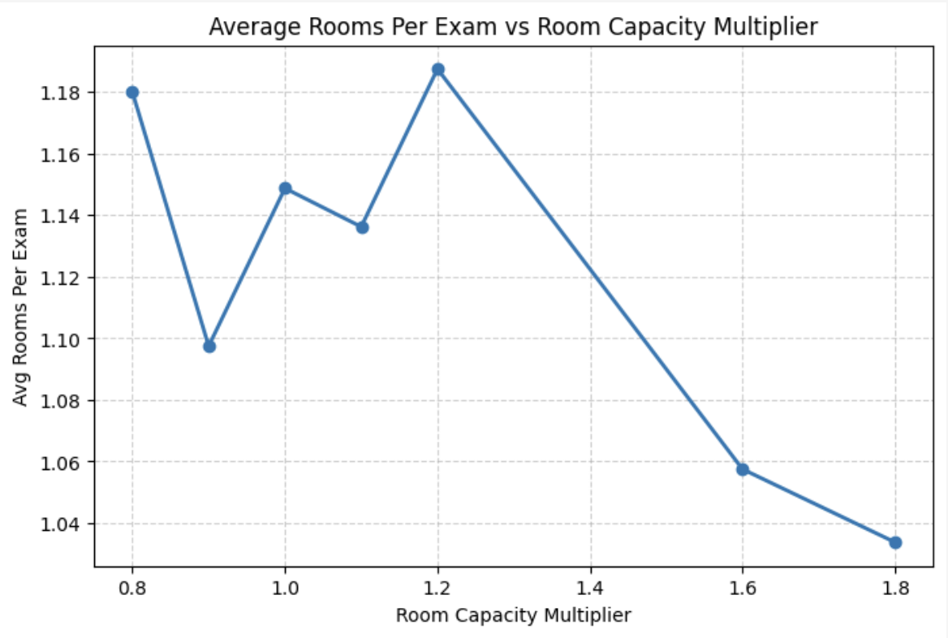
4. Sensitivity Analysis
The average number of rooms used per exam varies only modestly across feasible cases.
Average rooms per exam fluctuates rather than decreasing smoothly.
Room splitting is not driven solely by room size.
Notes:
it largely depend on structural rules such as: which limit time slots each exam can fit into or same-day gap constraints, which prevent many slot combinations.
Thus, even as rooms grow larger, splitting behavior remains similar because the solver is primarily constrained by where exams can be scheduled, not how many rooms they can occupy.

Slide 18
5. Next steps
Run more sensitivity analysis to see key bottlenecks or limiting factors that make exam scheduling difficult.
Answer how can it be applied or adapted to Denison’s exam system?
Finding weights for the objective function.

Slide 19
Thanks for listening!

